Slide 1
C# Inception: Analyzing .Net Code With Project Roslyn
Eric Potter / @pottereric
Aptera Software
Notes:
Have all three solutions open.
Have Euler9 open in Vim
[kick off joke] – ?
Roslyn is FASCINATING (intriguing)
“.Net Compiler Platform”
Thanks for coming out.
I hope you have some new tools in your tool box.
The tool are going to look at in this session is Roslyn.
Benefits from improved language and IDE.
Fascinating way to analyze code with code

Slide 2
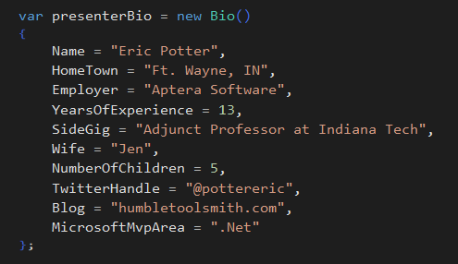
BIO
Notes:
Joke: 5 kids -> software project

Slide 3
WHAT IS ROSLYN?
Notes:
Yes it is a compiler
But it is a compiler with an API

Slide 4
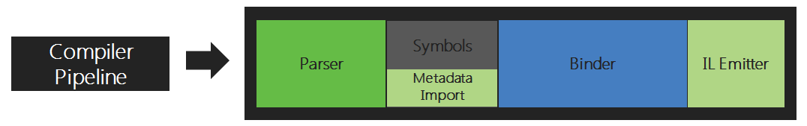
Traditional Compilers
* Image from http://msdn.microsoft.com/en-us/vstudio/roslyn.aspx
Notes:
Compilers have been black boxes

Slide 5
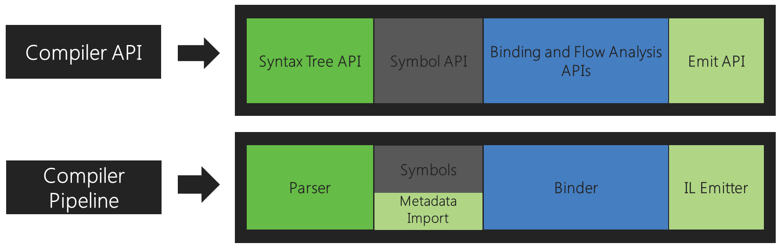
Roslyn
* Image from http://msdn.microsoft.com/en-us/vstudio/roslyn.aspx
Notes:
Current Compiler:
Who knows what language the C# compiler is written in?
Written in C++
Started development in the late 90s
According to Dustin Campbell, the Principal Program Manager on C#, VB, Project Roslyn, the compilers are getting to be hard to maintain.
It is hard to continue to update Visual Studio

Slide 6
ROSLYN
Languages: C# and VB
Compiler as a service? Yes and No
Used in ScriptCS
Used by ASP.Net vNext
Notes:
-Compiler as a service is not visualstudio.com
Demo ScriptCS
- strings
- DateTime.Now vs DateTime.UtcNow
a. Why was it created? b. Why do we want a compiler with an API?
- Analysis
- Code Issues
- Code Generation
- Refactorings

Slide 7
Open Source
https://github.com/dotnet/roslyn
Notes:
Open the Roslyn Solution
Andres did a demo at build where he added French quotes to the language on stage.
You could add an unless keyword

Slide 8
A BRIEF TOUR OF THE API

Slide 9
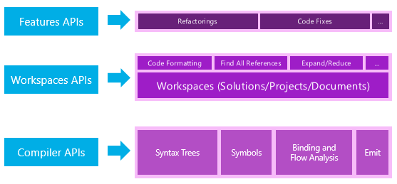
API Layers
Notes:
Feature APIs are dependent on Visual Studio.
We are going to focus on the compiler API.
Provides data structures for the syntactic and semantic aspects of the code.

Slide 10
INSTALLING THE ROSLYN SDK
Notes:
Install the SDK Preview.
The End User Preview gives you a new compiler.

Slide 11
INSTALL OPTIONS
Roslyn SDK
Console Application
Diagnostic with Code Fix
Code Refactoring
NuGet
Microsoft.CodeAnalysis.*
Visual Studio 2015
Notes:
Diagnostic with Code Fix: Custom Red Squiggles -> empty catch blocks

Slide 12
DIGGING INTO THE COMPILER API

Slide 13
CODE ANALYSIS
Analyze Code
Visualize Code
Refactor Code
Notes:
As programmers we often need to work with code we didn’t write.
As programmers we often need to know something about the quality of someone else’s code

Slide 14
In the same way that unit test’s allow us to test code with code, Roslyn allows us to understand code with code.

Slide 15
TREE STRUCTURE
SyntaxTree
SyntaxNodes
SyntaxTokens
SyntaxTrivia
Notes:
Simple intro [RoslynIntro.sln]
Uses the Microsoft.CodeAnalysis.Csharp Nuget package
Show the syntax tree class diagram [RoslynTreeViewer.sln]
Show the syntax tree visualizer [RoslynTreeViewer.sln]
Show euler9.cs and then MainWindow.xaml.cs

Slide 16
SAMPLES

Slide 17
Demos
Getting the access modifier information for all class members.
Getting location information for all method calls.
Notes:
a. A Visual Studio Extension [Synopsis.sln] (GameOfLifeTDD is a good test solution)
Look at SyntaxAnalyzer.cs
Look at MembersByAccessModifier.cs
b. Another visualizer (arcs} [RoslynExploration.sln]
Open D:\Projects\exploratory\RoslynExploration\RoslynExploration\TestClass.cs
Look at Semantic Analyzer.cs
Look at MethodCalls.cs
Other ideas
Commented out code delete
3D block visualizer

Slide 18


Slide 19
Q: WHAT IS THE COOLEST THING ABOUT ROSLYN?
A: What you and I will do with it!
Notes:
We are all toolsmiths, lets go build some tools

Slide 20
QUESTIONS?

Slide 21
Thank you
The code will be up on GitHub at GitHub.com/Pottereric
I’ll blog about the details of creating a Diagnostic at Humbletoolsmith.com
Notes:
As programmers we often need to work with code we didn’t write.
As programmers we often need to know something about the quality of someone else’s code

